Slide 1

Chapter 6: pronunciation
Lenne Swinnen
5EMb

Slide 2
Topics
Pronunciation
Unpredicatble letters
Fun fact
extra/less
Listen carefully
Shakespeare’s time
Stressing syllables
conclusion

Slide 3
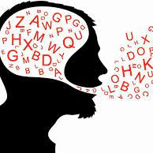
Pronunciation
No strict rules
range of possibilities
Finnish
English →many exceptions
race, rack, rich

Slide 4
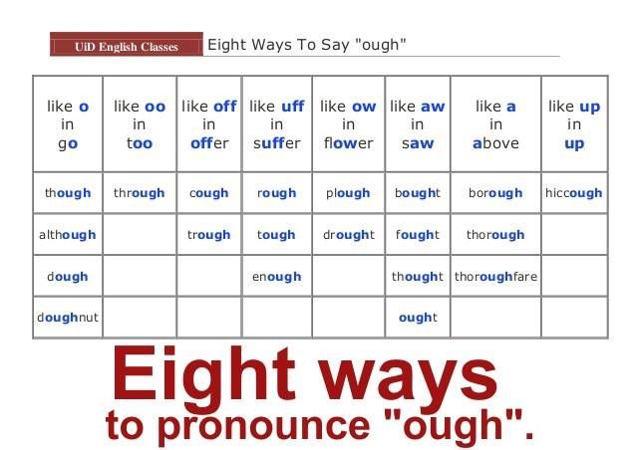
Unpredictable letters
Cluster ‘ough’
8 ways
chough

Slide 5

Fun fact
Chinese dialects→ monosyllabic
Peking’s dialect→ ‘n’ or ‘g’
Yi→ 215 words
‘ng’ English

Slide 6

extra/less
P between letters
‘somePthing’
The brits → less syllables
  ‘meejutly’- ‘nessree’
Americans→ syllables important
  less precisely
Helped: ‘helpt’-’help-ud’
future

Slide 7

listen carefully!
syllables → very quickly
listen very carefully
‘ I love you’ – ‘isle of view’

Slide 8
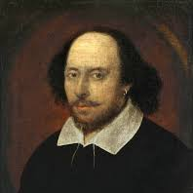
Shakespeare’s time
‘k’ in knight
Sea – see
  Sea→ see – saw
America→ colonised
Sheakspeare American??

Slide 9

stressing syllables
Before sheakspeare: ‘defect’→ stressed on second syllable
Few exceptions
more and more words 1 syllable
1700→ 35
1800→ 70

Slide 10

conclusion
No rules
Change of pronunciation
Misprounounce→ might be right!

Slide 11
Sources
Bill Bryson, mother tongue, Chapter 6: pronunciation
BookRags. (n.d.). The mother tongue summary & study guide. BookRags. http://www.bookrags.com/studyguide-the-mother-tongue/#gsc.tab=0

