Slide 1
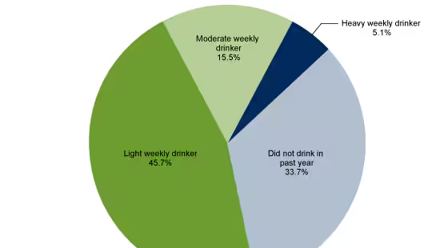

Slide 2

What are the effects of alcohol intoxications on language?
Lenne Swinnen 6EMb

Slide 3
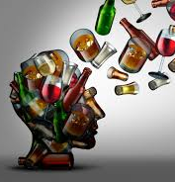
Table of contents
Cognitive effects
  Effects on the brain
  Blackout
  concentration
Linguistic effects
  Pronunciation
  Talkactiveness
  Grammatic
  Foreign language
  Voice
  Speech problems
  Communication
Conclusion

Slide 4
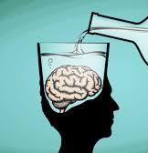
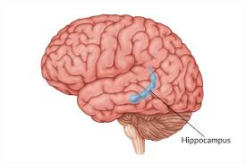
Cognitive effects
Cognitive effects = Effects on the brain
Blackout
  Alcohol
  Hippocampus
  Remember small parts: grey out
  Korsakov
Concentration
  Brain cells die

Slide 5
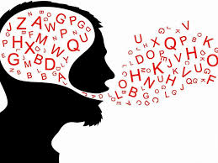
Linguistic effects-pronunciation
Native language
University of Groningen
  Extended vowels
  ‘s’
  Muscles

Slide 6
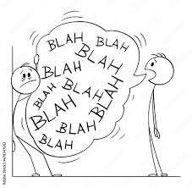
Linguistic effects-more talkative
Word choice
  Cursing
    Misinterpret + lose of empathy
Repetition
  Short-term memory

Slide 7
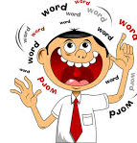
Linguistic effects-talk more/less?
Drunk people talk more
  You don’t care
  Major impact on the brain functions & transmission of impulses
  Narcotic function
  Whole brain starts working worse!
Drunk people talk less
  Drug
  CNSD

Slide 8
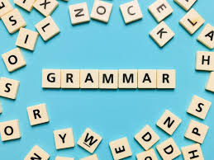
Linguistic effects-grammatical mistakes
No evidence

Slide 9
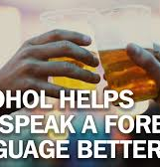
Linguistic effects-effects on a foreign language
Dutch and British researchers: experiment
  50 Native German speakers → low dose of alcohol
  Conversation in Dutch
Results
  More fluent
  Better pronunciation

Slide 10
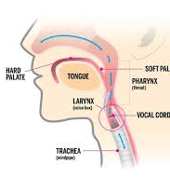
Linguistic effects-voice
To speak:
  vocal cords: hydrated
Alcohol: dehydrating effect
  Moisture
  cracked

Slide 11
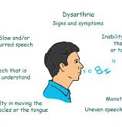
Linguistic effects-speech problems
Dysarthria
  Muscles are too weak
  Permanent
  Mumbling, whispering
  Brain Tumor
Neuropathy
  Nerve damage: permanent
  Muscle twitches

Slide 12
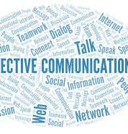
Linguistic effects-communication
Dirk De Ridder
  ‘Drunk people know what they do, but not what they say.’
  Left part: Area of Wernicke & Broca: not stable
    primal humans were not resistant
Other part: understanding metaphor
  Stable
    we have been doing this much longer
Non-verbal

Slide 13
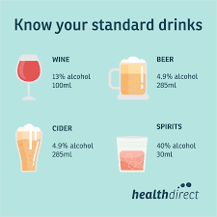
conclusion
Effects of intoxication
  Cognitive: Blackout, concentration
  Linguistic: Pronunciation, voice, speech problems

Slide 14
sources
Minho Moon,Department of Biochemistry, College of Medicine, Konyang University, Korea
Macmillan, A. (2017, October 20). Can Alcohol Help You Speak a Foreign Language? Time. https://time.com/4989850/alcohol-foreign-language-speak/
Offrede, T. ; Jacobi, J. ; Rebernik, T. ; De jong, L. ; Keulen, S.; Veenstra,P.; Noiray,A. ( August 28, 2020). The impact of alcohol on L1 versus L2. https://journals.sagepub.com/doi/full/10.1177/0023830920953169
Dinuzzo, E. (October 23,2017). Alcohol can help you speak a foreign language better — but there's a catch. Business Insider. https://www.businessinsider.com/alcohol-could-help-you-speak-a-foreign-language-2017-10?international=true&r=US&IR=T#:~:text=Although%20alcohol%20can%20help%20you,of%20psychological%20or%20biological%20reasons.

Slide 15
sources
Quora. (2018). Why do drunk people like to speak a foreign language? https://www.quora.com/Why-do-drunken-people-like-to-speak-a-foreign-language#:~:text=While%20intoxicated%2C%20you%20lose%20all,speak%20in%20a%20foreign%20language.
Pubmed. (1996) Anxiety, alcohol, aphasia and ums. https://pubmed.ncbi.nlm.nih.gov/8851740/#:~:text=Alcohol%2C%20which%20makes%20speaking%20harder,every%20word%2C%20produce%20many%20ums.
Centers for disease control and prevention. (November 13,2023) Data on excessive drinking. https://www.cdc.gov/alcohol/data-stats.htm#:~:text=According%20to%20the%20Behavioral%20Risk,drink%20heavily%20also%20binge%20drink.
Annika Hope. (08/02/2023). Losing voice after drinking. https://www.musicgateway.com/blog/how-to/alcohol-singers-how-does-it-affect-your-voice#:~:text=Your%20vocal%20folds%20need%20proper,voice%20sounding%20strained%20and%20cracked.
Editorial Staff. (25/10/2022). Alcohol and slurred speech. https://alcohol.org/health-effects/slurred-speech/
Quora. (2019). Why am I so silent after drinking? https://www.quora.com/Why-am-I-so-silent-after-drinking-Is-it-because-of-any-mental-problem#:~:text=Alcohol%20is%20basically%20a%20Central,a%20numbness%2C%20and%20your%20silent.

Slide 16
SOURCES
Jansen,R. (2024, 18 maart). Korsakov. https://www.alcoholinfo.nl/effecten/syndroom-van-korsakov
Procureur, G. (2011,22 december). “Zatte mensen weten wat ze doen, niet wat ze zeggen”. Het Nieuwsblad. https://www.nieuwsblad.be/cnt/2q3juv1u

